Slide 1
‘The Fundamental Error
Of the Theory of Evolution’
Sunday Service, August 2, 2016
[Notes exist under each slide]
Notes:
This presentation offers insight into God-denying ideologies and God’s Providential work in history. The title comes from the CSG I. First given in Hempstead, NY 2016.

Slide 2
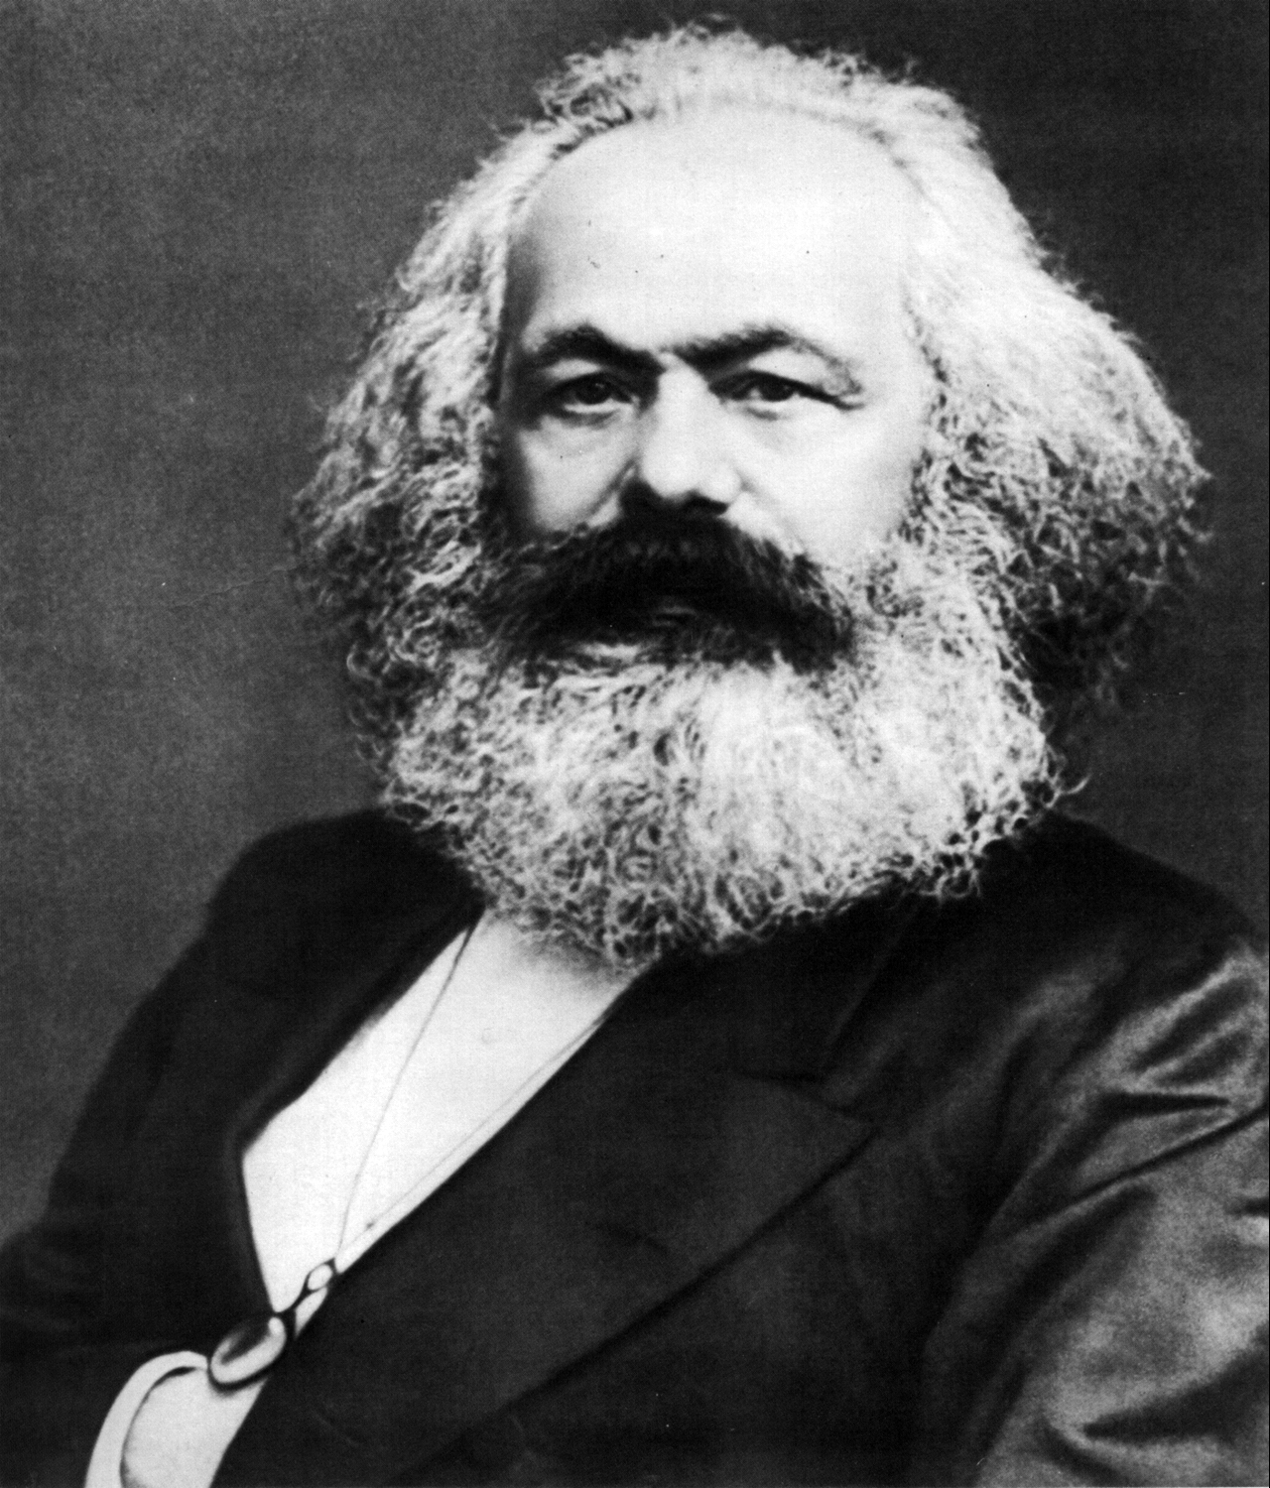
Karl Marx in 1875 (photo). Born 5 May 1818 Trier, Kingdom of Prussia, German Confederation: Died: 14 March 1883 (aged 64) London.
Notes:
Karl Marx’s ideology was materialistic, meaning in his theories he taught that the origin of life was physical or material. In the modern era Darwinists mostly accept similar origins. From pre-Socratic Greece, where materialism was widely accepted, we have in a sense come full circle, now atheistic Darwinism. CAUSA work.

Slide 3
Marxism, or Scientific Socialism, is the name given to the body of ideas first worked out by Karl Marx (1818-1883) and Friedrich Engels (1820-1895). In their totality, these ideas provide a fully worked-out theoretical basis for the struggle of the working class to attain a higher form of human society - socialism.
The study of Marxism falls under three main headings, corresponding broadly to philosophy, social history and economics - Dialectical Materialism, Historical Materialism and Marxist Economics [Das Kapital]. These are the famous “Three component parts of Marxism” which Lenin described.
In Defense of Marxism
Notes:
Introduction to Marxist thought.

Slide 4
Religions have helped fallen people gradually overcome their spiritual ignorance by stimulating their latent original mind to activity. They have been teaching people to focus their lives on the invisible, causal world of God. Since not everyone feels an immediate need for religion, only a few exceptional people attain spiritual knowledge rapidly. For the vast majority, spiritual growth remains a slow process. We see this from the fact that even today, with religions widespread throughout the world, people's spiritual level is often no better than that of people in ancient times.
On the other hand, everyone is familiar with the findings of science, which have greatly enhanced our knowledge of the physical world. Since science deals with practical matters, everyone feels a strong need for it. Thus, the increase in humankind’s knowledge of the physical world has generally been widespread and rapid. Furthermore, while the objects of religious study are in the intangible, transcendent world of cause, scientific research examines tangible, material objects in the world of result. Hence, to this day religion and science remain theoretically irreconcilable.
7.2.2 The Mutual Relations between Religious History, Economic History and Political History
Notes:
From DP Exposition. Ideologies are often divided between theism (internal) and materialism (external) allowing a separation to exist between religion and science. Secular humanist and fundamentalist materialist ideas advance often due to obstinate religious leaders and fundamentalist religious doctrines.

Slide 5
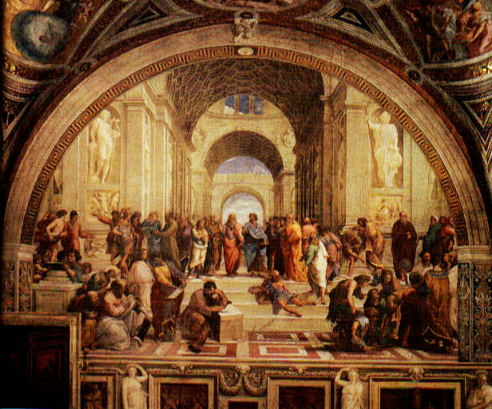
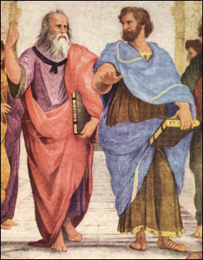
Raphael's School of Athens (1509)
Notes:
Had the people in Israel been truly united at the time of the United Kingdom, they could have formed a unity with the developing Greek culture, providing monotheism and revelation to the more advanced but more humanist Greek world. Later, God raises up Socrates (469-399 BC) in Greece. His two main intellectual descendants, Plato and Aristotle, although separated in their pursuits of knowledge, (Plato internal, absolute, internal values; Aristotle, external exploration or empirical). Depicted above: Plato at left, Aristotle at right. Even to this day they remain influential thinkers. The Greek culture was for its time highly advanced in science, mathematics, civics, democracy, art, philosophy, architecture.

Slide 6
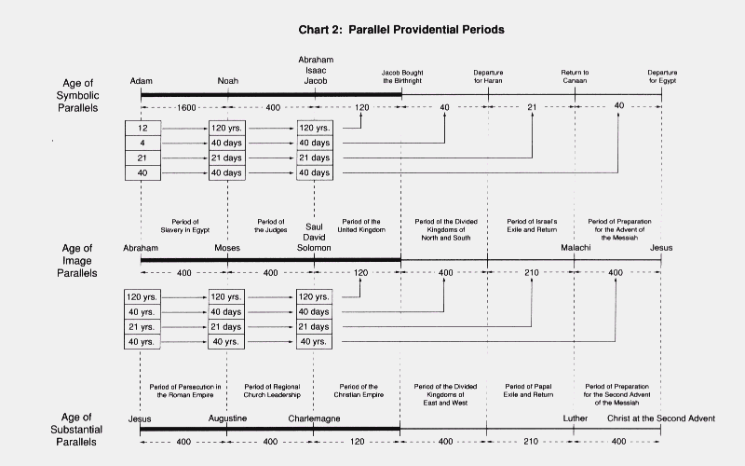
Notes:
Timeline from Divine Principle where the United Kingdom and the Greek culture could have formed a better unity. Western culture began circa 1000 BC. These parallel periods are not literal but approximate God’s providential history of salvation, or restoration. They have a certain meaning to God.

Slide 7
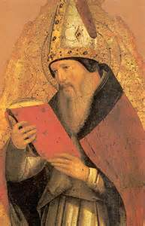
Augustine of Hippo
Augustine of Hippo (13 November 354 – 28 August 430), also known as Saint Augustine,
was an early Christian theologian and philosopher whose writings profoundly influenced
the development of Western Christianity and Western philosophy. He was bishop of Hippo
Regius (modern-day Annaba, Algeria). He is viewed as one of the most important Church
Fathers in Western Christianity for his writings in the Patristic Era.
Among his most important works are City of God and Confessions. According to his contemporary, Jerome, Augustine “established anew the ancient Faith.” In his early years, he was heavily influenced by Manichaeism and afterward by the Neo-Platonism of Plotinus. After his baptism and conversion to Christianity in 387, Augustine developed his own approach to philosophy and theology, accommodating a variety of methods and perspectives. Believing that the grace of Christ was indispensable to human freedom, he helped formulate the doctrine of original sin and made seminal contributions to the development of just war theory. When the Western Roman Empire began to disintegrate, Augustine developed the concept of the Catholic Church as a spiritual City of God, distinct from the material Earthly City. His thoughts profoundly influenced the medieval worldview. The segment of the Church that adhered to the concept of the Trinity as defined by the Council of Nicaea and the Council of Constantinople closely identified with Augustine's City of God.
Notes:
Augustine focused on the metaphysical because salvation through Jesus was the necessary preparation to receive the Messiah; belief in Jesus was the merit of the age.

Slide 8
The Period of the United Kingdom and the Period of the Christian Empire
In the period of the Christian empire, Charlemagne’s empire realized the ideal of the Christian state as set down in the City of God by Saint Augustine – who lived when the Christians had just been liberated from the Roman Empire, a time parallel to that of Moses.
Notes:
Charlemagne and the Pope made the condition to receive the Messiah, but it was lost by his descendants due to faithlessness, corruption and immorality. Augustine was the first great defender of Christianity. His book, the City of God, was instrumental in educating and defending Christianity during the Middle Ages. He would be considered a neo-Platonic philosopher, after Plotinus (born circa 205 AD). Augustine in DP plays a familiar role to Moses, leading people into the Promised Land of salvation.

Slide 9
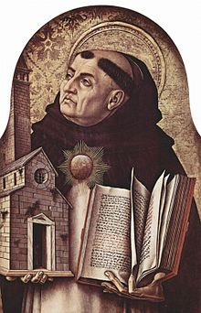
Thomas Aquinas
Tommaso d'Aquino, OP (1225 – 7 March 1274), also known as Thomas Aquinas,
was an Italian Dominican friar and Catholic priest who was an immensely influential
philosopher, theologian and jurist in the tradition of scholasticism, scholasticism,
within which he is also known as the “Doctor Angelicus” and “Doctor Communis.”
He is heralded as the most influential Western medieval legal scholar and theologist.
He was the foremost classical proponent of natural theology and the father of Thomism. His influence on Western thought is considerable, and much of modern philosophy was conceived in development or opposition of his ideas, particularly in the areas of ethics, natural law, metaphysics, and political theory. Unlike many currents in the Church of the time, Thomas embraced several ideas put forward by Aristotle — whom he referred to as “the Philosopher” — and attempted to synthesize Aristotelian philosophy with the principles of Christianity. The works for which he is best known are the Summa Theologica and the Summa contra Gentiles. His commentaries on Sacred Scripture and on Aristotle are an important part of his body of work. Furthermore, Thomas is distinguished for his eucharistic hymns, which form a part of the Church’s liturgy.
Notes:
God reintroduced Greek culture and ideas through Aquinas. The monks during the destruction of Rome and Constantinople had removed the library of ancient materials and hid them. The Greek ideas were reintroduced through the Islamic world during the period when Islam’s caliphate was open-minded, in the early years after Muhammed. The ideas filtered back into the Western World. Aquinas assimilated them into Catholicism, Aristotle’s ideas. According to subsequent research, many were in fact the Neoplatonic teachings of Plotinus, but labeled as “The Theory of Aristotle.”

Slide 10
The Period of Divided Kingdoms of North and South and the Period of the Divided Kingdoms of East and West
During the parallel period of the divided kingdoms of east and west, the papacy was corrupt. God sent prominent monks such as St. Thomas Aquinas and St. Francis of Assisi to admonish the papacy and promote internal reform in the Church.
Notes:
Obstinate, corrupt and faithless Catholic Church leaders prevented the successful conditions to unite the internal and external pursuits of knowledge. Without the Greek culture, there would have been little development of the Western World in science, art, architecture, education, civics, democracy, etc. Secular humanist proponents increasingly separated science from religion (Bacon, Hume). Subsequent religious leaders (Luther, Calvin) due to the literal biblical interpretation of “salvation through faith alone,” further removed it.

Slide 11
‘Theism and Materialism’
With regard to the mainstream ideologies of the world today, conceptualism [idealism] and realism [humanism] have become the two mainstreams of the philosophical world, giving rise to the conflict between theism and materialism, right and left wings, which has inflicted great damage on the world. Left-wing ideology, in particular, has attained worldwide supremacy through evolutionary theory.
Sun Myung Moon, Cheon Seong Gyeong (228-162, 1992.3.27)
Notes:
Politics reflects the conflict of values. In reality, studies of both theism and materialism offer critical knowledge of the internal and external worlds. Their relationship should be complimentary, subject-object, internal values guiding external pursuits.

Slide 12
We live in the physical world, but we know that this is not the only world that exists. There is also the spirit world. The spirit world is a definite reality. We also know that these two worlds, the physical and the spirit world, are not meant to be disconnected from each other. They should be linked together as one single world. We human beings, who were born from the spiritual world, eventually return to that world.
Sun Myung Moon, Understanding Life and Death, 1996
Notes:
How can even rocket scientists, for example, believe in six literal days of creation? The words in the Bible literally interpreted record or depict fantastic events. God uses these myths to give people hope during periods of terrible suffering in history, also to prevent false Messiahs.

Slide 13
[We] are ignorant of our most important responsibility. That responsibility is to prepare for eternal life. If we are clear about the concept of eternal life, and if we accept its reality in our hearts, then we can lead our children and our families properly. But in truth, most people are unsure if the spirit world even exists. If we truly understand the reality of the spirit world, we cannot sin, even when temptation presents itself. We cannot live selfishly, even if told to do so.
On the other hand, if we do not understand the spirit world, we cannot enter the Kingdom of God, no matter what our religion. On the larger scale, without knowing the meaning of eternal life, we cannot create a true social revolution. If it is not connected to eternal life, social revolution may make things worse. No one desires that.
To this day, religions have neither embraced nor encompassed the secular world. As a result, secularism now controls culture. Secularism overpowers the influence of religion. This happened because religions were unable to establish a clear concept of life in the next world, our eternal life.
Hak Ja Han, ALC Address, 1998
Notes:
People should live with an serious eye on their eternal life. From Mrs. Moon.

Slide 14
Today the development of science, and the modern civilization based on science, has succeeded in unifying the realm of external thought. We have a realm of unified thought on the world level. But internally, it is not science but religion that reveals the original human nature and character. Religion has to complete the mission of building an internally unified world, in which all people are one united body. Today science and religion are in conflict with each other, but it shouldn't be like that. God created the body of Adam and breathed the spirit into it so that Adam could stand as God's representative. Phenomena similar to this must take place in the Last Days. (003-106,1957 1006) Bk. II
Science studies the resultant world, while religion studies the world of heart. Until today, ideology has set forth the logic of cultural history. These three systems developed independently and separately, meaning religion according to religion, science according to science, and ideology according to ideology. Since God is one, He could not have been the one to divide them. In the Last Days, we should unite these three centered on God. (165-252,1987 0527) Bk. II
Notes:
Internal and external thought (religion/philosophy and science) and their place. Our responsibility remains to help unite ideologies by recognizing God’s purpose of creation.

Slide 15
The purpose of human life is to realize God's purpose of creation. A human being is a unified being of both physical and spiritual bodies. Hence, on the foundation of physical life, he or she is to lead a life of value, a life of love, truth, goodness and beauty. To put it simply, we need science and technology for our physical life, but we have to apply them in the framework of spiritual life. Science that disregards or fails to emphasize that life is based on values actually destroys human value systems. This contributes to today's reality of fear and insecurity. We can deliver humanity from this unfortunate situation only by searching for and discovering the authentic value perspective. Science in its turn has to align with this value perspective that, needless to say, has to be based on absolute values.
(106-053,1979 1123) Bk. II
Notes:
The purpose of life. Human beings have physical and spiritual needs. An authentic understanding of absolute values should incorporate the physical world and science.

Slide 16
Science attempts to explain the formulas, axioms, principles and laws of the created world and of all things in nature, Literature attempts to express the inner lyrical sentiment of nature, while the arts in their various forms express the apparent or hidden beauty of nature. Philosophy also tries to explain the basic principles of nature. Religion, however, is on a higher level than all of these [science, ideology]. Then what is it that true religion should explain? It should explain the deep emotional feeling that flows through the heart of nature. This is religion's responsibility. (006-340,1959 0628) Bk. II
Notes:
Religion is the highest pursuit because it seeks out a relationship with God. Freedom of thought, a legacy more of the humanist culture. Hebraism, the foundation of the Jewish people, begat a simpler culture but stressed revelation and monotheism, more direct communication with God. True religion centers on heart. A fallen world filled with struggle, corruption and immorality has prevented and obscured God’s efforts to obtain his goal, and prevented peace.

Slide 17
The Period of Religious and Ideological Conflict (1648-1789)
As modern people continued to pursue internal and external desires flowing from their original nature, they could not avoid divisions in theology and disputes among philosophies which arose as they exercised freedom of faith and thought.
Notes:
In our original nature we desire unity of mind and body in an environment of freedom, to pursue the desires of the original mind.

Slide 18
‘Scopes Monkey Trial’ 1925
Scopes Monkey Trial
(1925)
From Inherit the Wind
(1960)
William Jennings Bryan v.
Clarence Darrow, Dayton, TN
Bryan was prosecuting on behalf
of the World Christian
Fundamentalist Association,
who were against the teaching
of evolution. Darrow was defending
John Scopes.
Notes:
{Videos are not embedded and can be viewed on Youtube.] Fundamentalism opposed the teaching of evolution, and maintained strict adherence to biblical text. Thus, its toolbox was limited and often separated from scientific learning. They felt correctly, however, that any teaching not including God was wrong.

Slide 19
CNN debate 2014
Bill Nye v. Ken Ham
Creationist Museum
Petersburg, Kentucky
February 4, 2014
Notes:
A video extract of a modern debate reveals Christians could present a more sophisticated opposition to evolution, but continued to maintain literal adherence to Biblical text, even from some of the brilliant scientists who are introduced.

Slide 20
The Bible and Christianity
Since the parables and symbols in the Bible are open to various interpretations, there have arisen numerous disagreements among believers, causing them to divide into many denominations. The primary cause of these divisions lies in the character of the Bible, not in people.
DPIntroduction
Notes:
The nature of the Bible. It uses parables and symbols, many myths and fantastic events. Even the coming of Jesus is depicted in Daniel as him fighting a 10-headed beast, etc., as is Christ’s return in the New Testament’s “Revelation.”

Slide 21
The Creation Period
The universe did not suddenly spring forth complete, without regard to the flow of time. In fact, its origin and development took an enormous length of time. Therefore, the biblical period of six days for the completion of the universe is not to be reckoned by the number of literal sunrises and sunsets. It symbolizes six ordered periods of time in the creation process.
DPChapterOne
Notes:
We do not accept that the six days of creation mentioned in the Bible are literal days. There were six periods of evolution, the details of which are not easily understood either. After each great geological period, almost no life survived.

Slide 22
Cheon Seong Gyeong
“After the French Revolution and the process of development from humanism through the ideas of the enlightenment to communism, the latter united with Charles Darwin’s theory of evolution to drive Christianity into the pit of destruction.”
(213-65, 1991.1.14)
Notes:
TF on the problems of evolution and its effects on Christianity.

Slide 23
Cheon Seong Gyeong
“You have no idea how much evolutionary theory contributed to destroying Christianity.”
(240-297, 1992.12.13)
Notes:
TF on the problems of evolution and its effects on Christianity.

Slide 24
Cheon Seong Gyeong
“The world will become unstable without eliminating evolutionary theory and establishing the nucleus of absolute values based on a theory of creation, centered on the absolute God.”
(270-96, 1995.5.7)
Notes:
TF on the problems of evolution and its effects on Christianity.

Slide 25
Cheon Seong Gyeong
“How can we set the standard to absolutely deny materialism and evolutionary theory, to unite our minds and bodies, and to become the ideal starting point of a unified world? This has been the problem throughout world history.”
(270-96, 1995.5.7)
Notes:
TF on the problems of evolution and its effects on Christianity.

Slide 26
What do we believe?
How would we define ourselves in the debate between evolutionists and creationists?
The National Academy of the Sciences has some definitions. …
Notes:
If we don’t believe in the literal six days of creation or certain conclusions and speculation in the teaching of evolution, what do we believe?

Slide 27
Evolution or Creation?
A CREATIONIST: A creationist is a person who rejects the theory of evolution and believes instead that the each species on earth was put here by a Divine Being. A Creationist might accept “micro-evolution” (changes in the form of a species over time based on natural selection), but rejects the notion that one species can -- over time -- become another species.
YOUNG EARTH CREATIONIST: A young earth creationist believes that the earth is nowhere near the 4.6 billion or so years old that most scientists estimate, but is instead closer to 6,000 or so years old, based on the assumption the Genesis contains a complete listing of the generations from Adam and Eve to historical times.
Notes:
The National Academy provides definitions into how many scientists view and teach their opposition to religion and Creationism. It is representative of what many, if not most, evolutionists accept.

Slide 28
Evolution or Creation?
INTELLIGENT DESIGN PROPONENT: An ID proponent might or might not reject the theory of evolution. At a minimum, the ID proponent rejects that evolution is randomly driven or, more generally, the notion that natural law and chance alone can explain the diversity of life on earth. Instead, the ID proponent argues -- often from statistics -- that the diversity of life is the result of a purposeful scheme of some higher power (who may or may not be the God of the Bible).
Notes:
From the National Academy of the Sciences.

Slide 29
Evolution or Creation?
EVOLUTIONIST: An evolutionist accepts the Darwinian argument that natural selection and environmental factors combine to explain the diversity of life we see on earth. An evolutionist may or may not believe that evolution is the way in which a Divine Being has chosen to work in the world. Evolutionists divide into various camps, including PUNCTUALISTS (who believe that evolution usually occurs sporadically, in relatively short bursts, as the result of major environmental change) and GRADUALISTS (who are more inclined to believe that evolution occurs more evenly, over longer periods of time). The PUNCTUALISTS seem now to be winning the argument.
Notes:
From the National Academy.

Slide 30
Evolution or Creation?
“ ‘Intelligent design’ creationism is not supported by scientific evidence.”
“In addition to its scientific failings, this and other standard creationist arguments are fallacious in that they are based on a false dichotomy. Even if their negative arguments against evolution were correct, that would not establish the creationists’ claims.”
National Academy of the Sciences
Notes:
The National Academy writers make clear what they think of Intelligent Design and other fundamentalist-based explanations for life.

Slide 31
‘Punctuated Equilibrium’
“Punctuated equilibrium (also called punctuated equilibria) is a theory in evolutionary biology which proposes that most species will exhibit little net evolutionary change for most of their geological history, remaining in an extended state called stasis. When significant evolutionary change occurs, the theory proposes that it is generally restricted to rare and rapid (on a geologic time scale) events of branching speciation called cladogenesis. Cladogenesis is the process by which a species splits into two distinct species, rather than one species gradually transforming into another.
“Punctuated equilibrium is commonly contrasted against the theory of phyletic gradualism, which states that evolution generally occurs uniformly and by the steady and gradual transformation of whole lineages (called anagenesis). In this view, evolution is seen as generally smooth and continuous. In 1972, paleontologists Niles Eldredge and Stephen Jay Gould published a landmark paper developing this theory and called it punctuated equilibria. Their paper built upon Ernst Mayr's theory of geographic speciation, I. Michael Lerner's theories of developmental and genetic homeostasis,[4] as well as their own empirical research. Eldredge and Gould proposed that the degree of gradualism commonly attributed to Charles Darwin is virtually nonexistent in the fossil record, and that stasis dominates the history of most fossil species.”
Notes:
Various evolutiionists no longer accept the gradual evolution of species or phyletic gradualism, anagenesis.

Slide 32
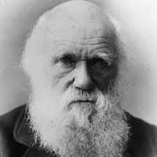
Charles Darwin (1809 – 1882)
Charles Robert Darwin, was an English naturalist
and geologist, best known for his contributions
to evolutionary theory.
His seminal work “On the Origin of Species,”
published in 1859, is a work of scientific literature
that is considered to be the foundation
of evolutionary biology.
On the Origin of Species by Means of Natural Selection, or the Preservation of Favoured Races in the Struggle for Life.
Notes:
Background on Charles Darwin, whose ideas form the basis for evolutionary biology today and evolutionary theory. At bottom is the original title of his book, which suggests his sympathies and belief in eugenics.

Slide 33
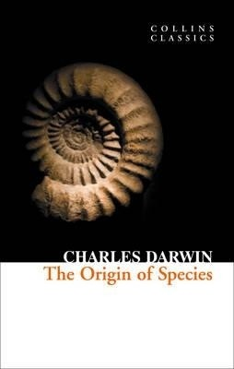
Charles Darwin (1809 – 1882)
“Still considered one of the most important and groundbreaking
works of science ever written, Darwin’s eminently readable
exploration of the evolutionary process challenged most of the strong
beliefs of the Western world. Forced to question the idea of the
Creator, mid-nineteenth century readers were faced with Darwin’s
theories on the laws of natural selection and the randomness
of evolution, causing massive controversy at the time. However,
Darwin’s theories remain instrumental in providing the backbone
to modern biology today.”
Collins Classics
Notes:
Collins Classics abstract from “Origin of Species,” mentioning “randomness of evolution.”

Slide 34
Teaching Evolution
A species is a population of organisms that interbreeds and has fertile offspring. Living organisms have descended with modifications from species that lived before them. Natural selection explains how this evolution has happened:
More organisms are produced than can survive because of limited resources. Organisms struggle for the necessities of life; there is competition for resources. Individuals within a population vary in their traits; some of these traits are heritable - passed on to offspring.
Some variants are better adapted to survive and reproduce under local conditions than others.
Better-adapted individuals (the “fit enough”) are more likely to survive and reproduce, thereby passing on copies of their genes to the next generation. Species whose individuals are best adapted survive; others become extinct.
http://www...wgbh/evolution/educators/course/session2/
Notes:
Basics of evolutionary theory: struggle, adaptation, genetic survival … none of which explain why genes move in a particular direction. Survival is not a direction. What makes these processes move forward? Purpose exists.

Slide 35
Teaching Evolution
Biological evolution, simply put, is descent with modification. This definition encompasses small-scale evolution (changes in gene frequency in a population from one generation to the next) and large-scale evolution (the descent of different species from a common ancestor over many generations). Evolution helps us to understand the history of life.
Biological evolution is not simply a matter of change over time. Lots of things change over time: trees lose their leaves, mountain ranges rise and erode, but they aren't examples of biological evolution because they don't involve descent through genetic inheritance.
The central idea of biological evolution is that all life on Earth shares a common ancestor, just as you and your cousins share a common grandmother.
Through the process of descent with modification, the common ancestor of life on Earth gave rise to the fantastic diversity that we see documented in the fossil record and around us today. Evolution means that we're all distant cousins: humans and oak trees, hummingbirds and whales.
‘Welcome to Evolution 101!’
The History of Life: Looking at the Patterns
http://evolution.berkeley.edu/evolibrary/article/evo_01
Notes:
Mentions “descent with modification.” This explains only the material side of life, and ignores internal or spiritual development and purpose, why things move in a certain direction.

Slide 36
Teaching Evolution
“Existing systems also can acquire new functions. For example, a particular system might have one task in a cell and then become adapted through evolutionary processes for different use. … Molecular biologists have discovered that a particularly important mechanism through which biological systems acquire additional functions is gene duplication. Segments of DNA are frequently duplicated when cells divide, so that a cell has multiple copies of one or more genes. If these multiple copies are passed on to offspring, one copy of a gene can serve the original function in a cell while the other copy is able to accumulate changes that ultimately result in a new function. The biochemical mechanisms responsible for many cellular processes show clear evidence for historical duplications of DNA regions.”
Mutations are Random
The mechanisms of evolution—like natural selection and genetic drift—work with the random variation generated
by mutation. Factors in the environment are thought to influence the rate of mutation but are not generally thought to influence the direction of mutation.
‘Welcome to Evolution 101!’
The History of Life: Looking at the Patterns
http://evolution.berkeley.edu/evolibrary/article/evo_01
Notes:
Mutations, the basis of genetic and all development, are random, according to evolutionary theory, which is still widely taught today. No purpose or direction exists, they say, only the mysterious engine of movement known as natural selection.

Slide 37
Teaching Evolution
“Natural selection can only work on existing variation within a population. Such variations arise by mutation, a change in some part of the genetic code for a trait. Mutations arise by chance without foresight for the potential advantage or disadvantage of the mutation. In other words, variations do not arise because they are needed.”
(University of Michigan in “Global Change”)
Notes:
Evolutionists teach populations develop from mutation, and do so not as “needed.”

Slide 38
Teaching Evolution
1) National Selection, interbreeding
2) Descent with Modification
3) Random Mutation
ran•dom (ˈræn dəm)
adj.
1. occurring or done without definite aim, reason, or pattern.
Notes:
National Selection, Descent with Modification, Randomness. Definition of the word “random.”

Slide 39
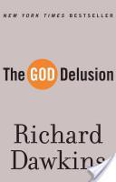
‘The God Delusion’
The God Delusion
Front Cover
Richard Dawkins
Houghton Mifflin Harcourt, Jan 16, 2008 - Science - 416 pages
2970 Reviews
A preeminent scientist—and the world’s most prominent atheist—asserts the irrationality
of belief in God and the grievous harm religion has inflicted on society, from the Crusades to 9/11.
With rigor and wit, Dawkins examines God in all his forms, from the sex-obsessed tyrant of the Old Testament to the more benign (but still illogical) Celestial Watchmaker favored by some Enlightenment thinkers. He eviscerates the major arguments for religion and demonstrates the supreme improbability of a supreme being. He shows how religion fuels war, foments bigotry, and abuses children, buttressing his points with historical and contemporary evidence. The God Delusion makes a compelling case that belief in God is not just wrong but potentially deadly. It also offers exhilarating insight into the advantages of atheism to the individual and society, not the least of which is a clearer, truer appreciation of the universe’s wonders than any faith could ever muster.
Notes:
Book abstract celebrating atheist Richard Dawkins and his book, “The God Delusion.“

Slide 40
‘The God Delusion’
From The God Delusion …
“Any creative intelligence, of sufficient complexity to design anything, comes into existence only
at the end of an extended process of gradual evolution.”
“Creative intelligences, being evolved, necessarily arrive late in the universe; therefore cannot be
responsible for designing it. God in the sense defined is a delusion ... a pernicious delusion.” p31
“I am attacking God, all gods, anything and everything supernatural.” p34
“According to prominent evolutionist Stephen J Gould, ‘we neither affirm nor deny [God]; science
simply cannot (by its legitimate methods) adjudicate the issue of God’s superintendence of nature.’” p55
“If they [answers] lie beyond science, they most certainly lie beyond the province of theologians as well.” p56
“Evolutionary biology disproves the idea of a creator God.” p67
[At the same time, we are told by Richard Dawkins, "The general lesson we should learn is never
to use human judgment in assessing such matters." (River Out of Eden, BasicBooks, 1995. p 70).]
Notes:
Quotes from “The God Delusion.” His view is that a true evolutionist must be a materialist.

Slide 41
‘The God Delusion’
On page 14, he defines his atheism: “Human thoughts and emotions emerge
from exceedingly complex interconnections of physical entities within the brain.
An atheist in the sense of philosophical naturalist is someone who believes
there is nothing beyond the natural, physical world, no supernatural creative
intelligence lurking behind the observable universe, no soul that outlasts
the body and no miracles – except in the sense of natural phenomena
that we don’t yet understand.” [ital. Dawkins’]
Julian Baggini explains in Atheism: A Very Short Introduction, a naturalist atheist
is someone who believes that there exists “only one kind of stuff in the universe,
and it is physical, out of this stuff comes minds, beauty, emotions, moral values
that gives richness to human life.”
Notes:
View of a materialists, that internal character (consciousness) arises from interaction with material. Matter here is considered as subject, produces character, which is object, and which is n fact a complete reversal of how one understands reality.

Slide 42
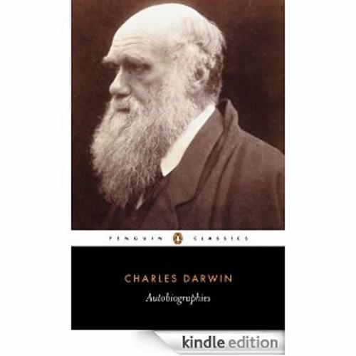
Darwin’s Autobiography
From the pages of the
Autobiography of Charles Darwin
Published in 1887
Notes:
A look at Darwin’s only source of personal reflection, his autobiography.

Slide 43
Darwin’s Autobiography
“That there is much suffering in the world no one disputes. Some have attempted to explain this in reference to man by imagining that it serves for his moral improvement. But the number of men in the world is nothing compared with that of all other sentient beings, and these often suffer greatly without any moral improvement. A being so powerful and so full of knowledge as a God who could create the universe is to our finite minds omnipotent and omniscient, and it revolts our understanding to suppose that his benevolence in not unbounded, for what advantage can there be in the sufferings of millions of lower animals throughout almost endless time? This very old argument from the existence of suffering against the existence of an intelligent first cause seems to me a strong one; whereas, as just remarked, the presence of much suffering agrees well with the view that all organic beings have been developed through variation and natural selection.” p.93
Notes:
How did Darwin arrive at his worldview? He explains a little of how his thinking developed (or how he justifies removing God from the equation). To wit, if God is all knowing and powerful, why would he create a world with so much suffering?

Slide 44
Darwin’s Autobiography
“Another source of conviction in the existence of God, connected with reason and not with feelings, impresses me as having much more weight. This follows from the extreme difficulty or rather impossibility of conceiving this immense and wonderful universe, including man with his capability of looking far backwards and far into futurity, as the result of blind chance or necessity. When thus reflecting I feel compelled to look for a First Cause having an intelligent mind in some degree analogous to that of man; and I deserve to be called a Theist.” p.94 …
Notes:
At first Darwin says he struggled to conceive of such an “immense and wonderful universe” that didn’t have a First Cause, God. Darwin grew up in a Christian society and married his first cousin, Emma Wedgwood.

Slide 45
Darwin’s Autobiography
“This conclusion was strong in my mind about the time, as far as I can remember, when I wrote Origin of Species; and it is since that time that it has very gradually with many fluctuations become weaker. But then arises the doubt -- can the mind of man, which has, as I fully believe, have developed from a mind as low as that possessed by the lowest animal, be trusted when it draws such grand conclusions? May not these be the result of the connection between cause and effect which strikes us as a necessary one, but probably depends merely on inherited experience? Nor must we overlook the probability of the constant inculcation in a belief in God on the minds of children producing so strong and perhaps an inherited effect on their brains not yet fully developed, that it would be as difficult for them to throw off their belief in God as for a monkey to throw off its instinctive fear and hatred of a snake? p.94
Notes:
He concludes that, if humans developed from simple life forms, how can we draw such “grand conclusions?” Maybe it’s all just brainwashing we receive in childhood.

Slide 46
Darwin’s Worldview
“Annie’s cruel death destroyed Charles’s tatters of beliefs in a moral, just universe. Later he would say that this period chimed ‘the final death-knell for his Christianity,’ says a recent biography of Charles Darwin. … Charles now took his stand as an unbeliever.”
(Desmond, A., and Moore, J., Darwin: The Life of a Tormented Evolutionist,
W.W. Norton and Company, New York, p. 387, 1991).”
Notes:
The final nail in the heart for him was the death of his 12-year-old daughter.

Slide 47
Darwin’s Autobiography
“I cannot pretend to throw the least light on such abstruse problems. The mystery of the beginning of all things is insoluble by us; and I for one must be content to remain an Agnostic.”
p.94
Notes:
He says our origins cannot be understood. As a belief system it resembles Deism, that whatever started the universe is not intimately involved but is a runaway machine.

Slide 48
Critique
Cheon Seong Gyeong
Notes:
Taken from CSG, mostly book I.

Slide 49
True Father’s Critique
4.1.2. Laws of the action of energy and fabrications of evolutionary theory
In thermodynamics, if a process occurs based on the input and output of energy, a loss must be incurred; that is, the energy level will decrease. Where does the logic arise that it will increase? The term “evolution” suggests that with the passage of time some elements are added to a being and with that addition it becomes greater. The question is, from where did those additional elements come? Where can you find the logic that justifies output as being greater than input? The logic of evolution cannot be established. Created beings cannot take in another source of energy in this process. In the world of motion output that is greater than input can never be produced, for if it were, it would give rise to unlimited power [perpetual energy].
Notes:
An input of energy is required for multiplication. Development takes place between reciprocal objects, complimentary elements, as stamen and pistol or positive and negative polls on a magnet. Only complimentary relationships progress. Entropy, as we understand the laws of thermodynamics, excludes perpetual energy.

Slide 50
True Father’s Critique
4.1.2. Laws of the action of energy and fabrications of evolutionary theory
Evolutionary theory is used to explain today’s world, but in order for amoebae to reproduce species that are greater than themselves in their present state, an extra input of energy must be added. In short, additional energy is necessary. Can the amoeba induce additional energy all by itself in order to develop? Does it have such ability? For it to climb a little higher and become something bigger, it needs greater energy within itself. Since it does not have the ability to create additional energy by itself, from where would it procure this extra energy?
(89-73, 1976.7.11)
Notes:
Greater energy comes when subject and object engage in a reciprocal relationship based on mutual purpose. A tree grows from a seed, in which the entire blueprint is contained. Genes don’t develop energy.

Slide 51
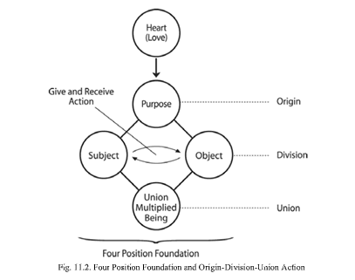
Origin, Division, Union
Universal
Prime
Force (UPF)
Notes:
When the UPF energy input ends, objects deteriorate according to the force of entropy. With no input of energy, things return to a base state. Ashes to ashes, and so on.

Slide 52
True Father’s Critique
4.1.1 Strict distinction of species and absolute rejection of intervention
In order to advance from a lower class of existence to a higher one, it would be necessary to pass through all the different levels of love between male and female. In other words, one would have to pass through a great number of levels of love. You all know that a sparrow and a bunting are very similar. While their feathers are of slightly different hues, their bone structure is identical. But for all their similarities, if you were to mate a sparrow with a bunting, would they reproduce? Evolutionists, give me an answer. Try mating them. They will never reproduce. …
(201-146, 1990.3.30)
Notes:
UPF energy exists to fulfil God’s overriding direction of His ideal and purpose. Species don’t intermingle and develop as hybrids; a rose is a rose. Even the closest species of birds don’t engage in reproduction. They follow a clear evolutionary intent, no intermingling. Love is actually the prime mover and advances everything toward God’s goal. Even if species appear nearly exactly the same, their purpose may be different and hence do not mate. Evolution as taught does not accept purpose.

Slide 53
True Father’s Critique
4.1.1 Strict distinction of species and absolute rejection of intervention
In an environment, there must be subject and object partners, and they must unite and form an interactive relationship as such. Simply put, subject and object partners must build a reciprocal relationship. Thus, one cannot live alone. One’s mind and body are in a relationship as subject and object partners. If the subject does not recognize the object, no connection can be made. Even in the world of chemistry, if there is no affinity between two elements, however much they are forced to fuse together in the laboratory nothing will come of it. If they are compatible, they will fuse together instantaneously on contact.
(291-112, 1998.3.5)
Notes:
Subject and object exist to fulfill a purpose, the purpose of creation. If things aren’t compatible, if they are not reciprocal, they will not engage. If they are complimentary, they “fuse together.”

Slide 54
True Father’s Critique
4.2. The Theory of Evolution is an outdated idea
We can now perceive through the microscope a whole world of germs millions of times smaller than the amoeba. If evolution had begun from the amoeba, would the male and female germs have existed before the amoeba or after?
203-323, 1991.1.11
[Michael Behe asserts that the complicated biological structures in a cell exhibit the exact same irreducible complexity that we see in humanly-devised machinery; in other words, they are all-or-nothing systems - either everything is there and it works, or something is missing and it doesn't work. Michael J. Behe, Ph.D. Professor Biochemistry, Lehigh University, PA]
Notes:
Genes have within themselves an entire blueprint for their growth and development. Capabilities are not developed nor absorbed. Increasingly, scientists are recognizing the incredible “machinery” they contain. (See Aristotle and his idea of embryonic development, his teleology. Plato understood “forms” preexist.)

Slide 55
True Father’s Critique
4.2. The Theory of Evolution is an outdated idea
The theory claimed that evolution brought about progression. If so, why can’t evolution take place in reverse? Could it not occur in the reverse order, or in any direction, whether east or west? Who decided the direction in which to evolve? Can the evolving beings designate the direction themselves? To develop from amoeba to human, numerous stages on successively higher levels need to be traversed, and the question is: who set the direction in which to develop towards a higher level? In other words, why must the creation develop toward a higher level?
166-212, 1987.6.7.
Notes:
What drives life forward? DP explains that life and history have a goal, the fulfillment of God’s ideal. Numerous stages from simple cell to final creation all follow the same principle and purpose: the fulfilment of that goal.

Slide 56
Notes:
Many wrong ideas have been perpetrated by people who believe in randomness. One obvious is the canard that monkeys would eventually type Shakespeare. This isn’t really taught as evolution but people still believe it.

Slide 57
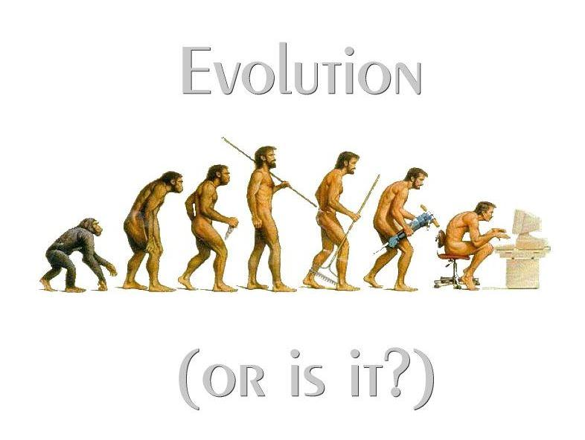
Probability of Evolution
“[A] time-honored adage about the laws of probability”?
Definition of adage: “A proverb or short statement expressing a general truth.”
The computer scientist chose a 9-letter string. Why not chose one letter?
When monkeys type all 26 letters of the alphabet—the same letters
Shakespeare used—then I could claim that my monkeys have typed
Shakespeare. And they will have done it in a lot less time than using nine-character strings.
Stephen Shankland, in Virtual Monkeys Recreate Shakespeare? Methinks Not, chose 63 characters. He points out that for virtual monkeys to come up with a particular 63-character string from Shakespeare would be 1 chance in 26 to the power of 63. That is, he says, “1.4 billion times the number of atoms in the visible universe. Give or take.”
“A Lover’s Complaint” has 335 sentences, 2,562 words and is just one of hundreds of Shakespeare’s works that total over 40,000 words. The odds are fantastically tiny.
Notes:
Mathematical probability statements argue not for randomness but against it. Have humans managed to create another Shakespeare? There is only one Shakespeare in history, one Davinci, one J.S. Bach, etc.

Slide 58
Probability of Evolution
“The probability of a universe full of monkeys typing a complete work
such as Shakespeare’s A Lover’s Complaint is so tiny that the chance
of it occurring during a period of time is actually thousands of times
longer than the age of the universe and is extremely small
(but technically not zero).”
How ironic too that monkeys would write, as Shakespeare did in Henry V:
“God shall be my hope, my stay, my guide and lantern to my feet”?
Notes:
Probability against random development is more than 50 trillion times the number of atoms in the universe, fantastically tiny. Also, would monkeys eventually write about desire and belief in God as Shakespeare did in Henry V?

Slide 59
True Father’s Critique
4.1.1 Strict distinction of species and absolute rejection of intervention
Even since the onset of life, human beings have followed religion. Do monkeys try to unite the world through culture? Do they invade and occupy other nations as their own or build national boundaries to distinguish between their nation and others? They are different in kind from human beings. Do monkeys glorify God? All they like to do is eat and reproduce and that is it. Human beings and monkeys are completely different. Scholars and experts asserting evolutionary theory are deceiving others in unduly insisting that monkeys evolved into people. The Unification Church should clarify that their assertions are wrong and set things right.
(41-185, 1971.2.15)
Notes:
Monkeys will never do anything else but what they have always done.

Slide 60
True Father’s Critique
4.1.2. Laws of the action of energy and fabrications of evolutionary theory
Today’s evolutionary theory should recognize that advancement is based on the principle of subject-object relationships. The minds of these two beings should be in accord and be stimulated through a greater mutual purpose. Only when they are spurred on to pursue the fulfillment of that purpose together can they rise to a higher place. Thus, there must be subject and object partners. The stimulation arising between the two is called love. (265-190, 1994.11.21)
Notes:
Advancement takes place through mutual purpose of subject and object. The resulting simulation is love. DP explains why.

Slide 61
Evolution or Creation?
4.2. The Theory of Evolution is an outdated idea
The one flaw in all of religion is that they do not explain the process of creation. They do not talk about the process and purpose of God’s Creation. Much has been written based on all types of logic. Since they do not deal with the concept of creation, they do not know the direction and purpose of the creation. Hence, everyone in the world is doing as they please, coming up with evolutionary theory and other damaging ideas. That being so, we should clearly understand about the concept of creation.
Notes:
TF identifies the direction and purpose of history, which religions have not and do not. Their understanding is foggy at best. Only DP clearly explains why history has progressed, even to this point.

Slide 62
Evolution or Creation?
4.2. The Theory of Evolution is an outdated idea
We need to inquire as to why this world became so evil when the direction and purpose of the creation did not intend this. After discovering this, we need to work out, going back to the very beginning, why entire nations met with destruction in the process of history, as narrated by the Holy Scriptures and human history. There must a historical view with a logical approach that can be justly approved by everyone from both general and practical standpoints.
203-323, 1991.1.11
Notes:
DP explains why history has unfolded as it has, the conflict in history, the world wars, but also the ultimate goal.

Slide 63
Evolution or Creation?
4.2. The Theory of Evolution is an outdated idea
With regard to the mainstream ideologies of the world today, conceptualism and realism have become the two mainstreams of the philosophical world, giving rise to the conflict between theism and materialism, right and left wings, which has inflicted great damage on the world. Left-wing ideology, in particular, has attained worldwide supremacy through evolutionary theory. What comes first: the existence of man and woman or the existence of love? Before there was man and woman, there existed the concept of love. Since love pre-existed them, man and woman were created to be prepared for it, that is, to be in accord with the concept of love. Hence, conceptualism and realism are not separate. What communism did not know was that conceptualism and realism can be unified through love in such a manner.
(228-162, 1992.3.27)
203-323, 1991.1.11
Notes:
The rest of TF’s quote: before anything else, love drives the Creation forward toward a goal. The “forms” for creation exist in his mind before the physical creation. The invisible and visible worlds are unified by love, just as man and woman are. Religion and science can work together when this is understood.

Slide 64
A big question these days is whether the theory of evolution is true or the theory of creation is true. Who determines the direction of evolution? Can a being do so by itself? Can a developing being make this decision on its own? Another question is this: How can such a being gather, cultivate and increase power in order to form a relationship with the realm of the ideal? Such things become possible only with God. The question cannot be answered by science. The desire for union with God exists within all matter, just as it does within human beings. It is the very purpose of material existence. In this sense, human beings are the representatives of the material world and the synthesis of all the elements in the universe. (111-127,1981 0208) Bk. II
Notes:
Basic conclusions. Logic and experience, including mathematics, reject evolution as taught today. One other point: male-female multiplication et. al is actually not a very efficient means of multiplication.

Slide 65
God Bless!
alan.thibideau@gmail.com
Notes:
Hardly the end of the discussion but maybe a beginning. Read the Divine Principle. Email me at the above address. I’m a former member of CAUSA International based in the NYC office.

